Slide 1
22C:19 Discrete Structures Introduction and Scope: Propositions
Spring 2014
Sukumar Ghosh

Slide 2
The Scope
Discrete mathematics studies mathematical structures that are fundamentally discrete, not supporting or requiring the notion of continuity (Wikipedia).
Deals with countable things.

Slide 3
Why Discrete Math?
Discrete math forms the basis for computer science:
Sequences
Counting, large numbers, cryptography
Digital logic (how computers compute)
Algorithms
Program correctness
Probability (includes analysis of taking risks)
“Continuous” math forms the basis for most physical and biological sciences

Slide 4
Propositions
A proposition is a statement that is either true or false
“The sky is blue”
“Today the temperature is below freezing”
“9 + 3 = 12”
Not propositions:
“Who is Bob?”
“How many persons are there in this group?”
“X + 1 = 7.”

Slide 5
Propositional (or Boolean) variables
These are variables that refer to propositions.
Usually denoted by lower case letters p, q, r, s, etc.
Each can have one of two values true (T) or false (F)
A proposition can be:
A single variable p
A formula of multiple variables like p ∧ q, s ∨¬r)

Slide 6
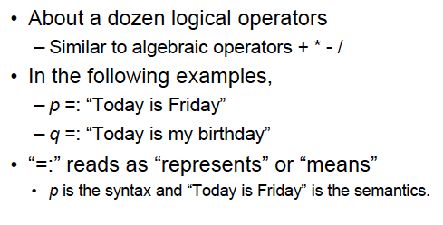
Propositional (or Boolean) operators

Slide 7
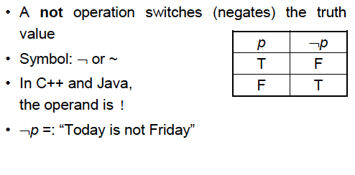
Logical operator: NOT

Slide 8
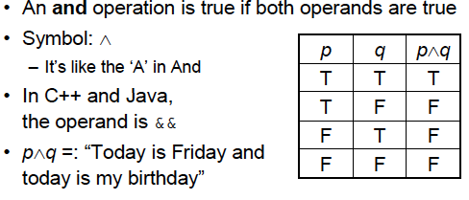
Logical operator: AND

Slide 9
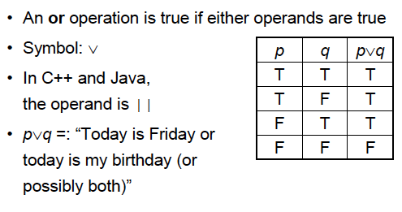
Logical operator: OR

Slide 10
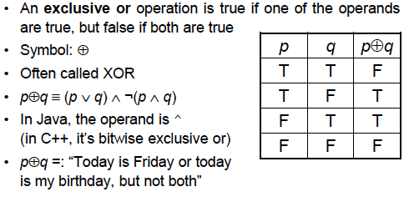
Logical operator: EXCLUSIVE OR
Note. p ⊕ q is false if both p, q are true or both are false

Slide 11
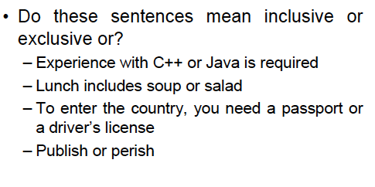
(Inclusive) OR or EXCLUSIVE OR?

Slide 12
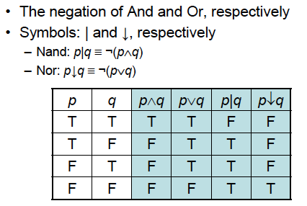
Logical Operator NAND and NOR

Slide 13
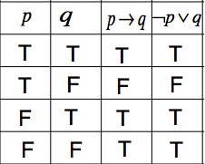
Conditional Operator
A conditional, also means an implication means
“if then ”:
Symbol: as in
Example: If this is an apple ( )
then it is a fruit ( )
The antecedent
The consequence

Slide 14
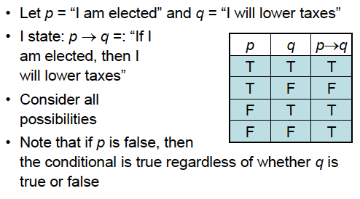
Conditional operators

Slide 15
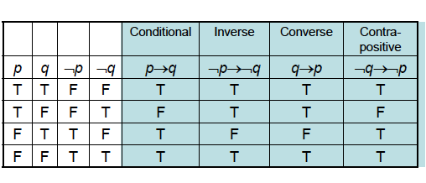
Conditional operators

Slide 16
Set representations
A proposition p can also be represented by a set (a collection of elements) for which the proposition is true.
Universe
p
p
p
p ∧ q
p
q
q
¬p
p ∨ q
Venn diagram

Slide 17
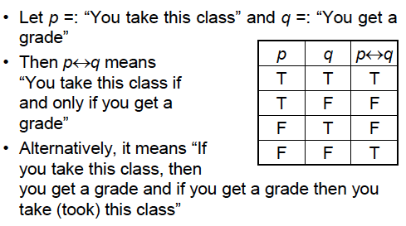
Bi-conditional Statements

Slide 18
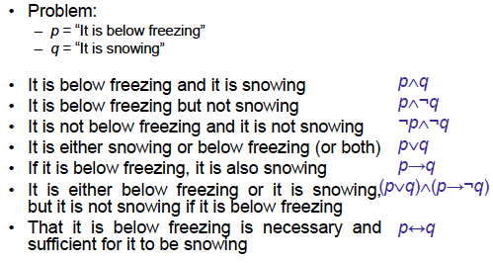
Translating into English

Slide 19
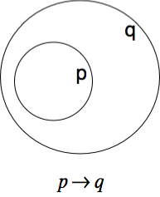
Translating into English
Great for developing intuition about propositional operators.
IF p (is true) then q (must be true)
p (is true) ONLY IF q (is true)
IF I am elected (p) then I will lower taxes (q)
p is a sufficient condition for q
q is a necessary condition for p

Slide 20
Translating into English
Example 1. p = Midwest q = Iowa
if I live in Iowa then I live in the Midwest
I live in Iowa only if I live in the Midwest
Example 2. You can access the Internet from campus only if you are a CS major or an ECE major or a MATH major, or you are not a freshman (f):
(cs ∨ECE∨MATH ∨ ¬ f) ⟶ Internet

Slide 21
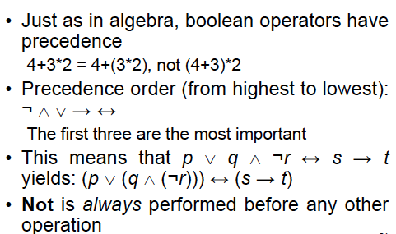
Precedence of Operators

Slide 22
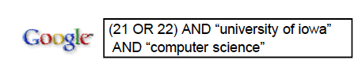
Boolean operators in search

Slide 23
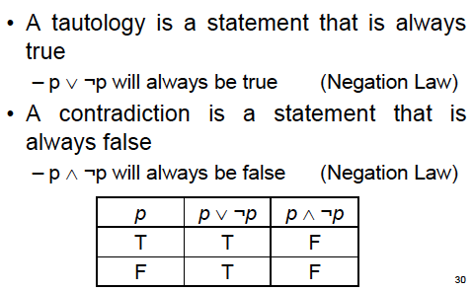
Tautology and Contradiction

Slide 24

Equivalence

Slide 25
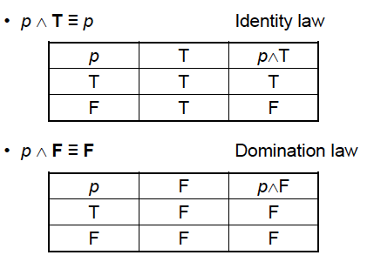
Examples of Equivalence

Slide 26
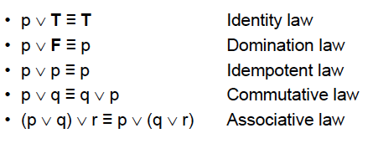
Examples of Equivalence

Slide 27

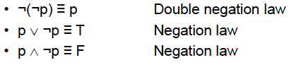


More Equivalences
Associative Laws
Distributive Law
Law of absorption

Slide 28
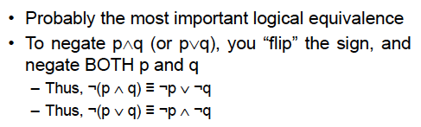
De Morgan’s Law
You can take 22C:21 if you take 22C:16 and 22M:26
You cannot take 22C:21 if you have not taken 22C:16 or 22M:26

Slide 29
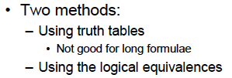
How to prove Equivalences
Examples? Follow class lectures.

Slide 30

Muddy Children Puzzle
A father tells his two children, a boy and a girl, to play in the backyard
without getting dirty. While playing, both children get mud on their
foreheads. After they returned home, the father said: “at least one
of you has a muddy forehead,” and then asked the children to answer
YES or NO to the question: “Do you know if you have a muddy forehead?”
the father asked the question twice. How will the children answer each time?

Slide 31
Wrap up
Understand propositions, logical operators and their usage.
Understand equivalence, tautology, and contradictions.
Practice proving equivalences, tautology, and contradictions.
Study the Muddy Children Puzzle from the book.

